Slide 1
05 — Hardware Components & Software Technologies
Slide 8 (Updated)
Category | Component | Spec / Notes
Sensing | 360° LiDAR — YDLIDAR X4 | Range 0.12–10m, 0.5° res., UART 3.3V, 10Hz, Class-1 eye-safe laser
 | ★ Camera Module 3 (Sony IMX708) | 12MP, autofocus, HDR, CSI-2 interface, via Raspberry Pi Zero 2W
 | ★ VL53L1X ToF Sensor | ±1mm accuracy, 4m range, I2C, 50Hz output, STMicro, ~$5
 | ★ Load Cell 5kg + HX711 | ±1g accuracy, 24-bit ADC, SPI/UART, logs object weight per scan
 | AS5048A Magnetic Encoder | 14-bit absolute angle, SPI, ±0.022° angular resolution
 | MPU-6050 IMU | 6-DOF accel+gyro, I2C, vibration and platform tilt detection
Control | ESP32 WROOM (Main MCU) | Dual-core 240MHz, 520KB RAM, Wi-Fi+BLE, FreeRTOS, 6 tasks
 | ★ Raspberry Pi Zero 2W | 1GHz quad-core, 512MB RAM, CSI port, Wi-Fi, runs PiCamera2
 | TMC2209 Motor Driver | Microstepping ÷256, silent, UART config, stall detection
Actuation | NEMA17 Stepper Motor (×2) | 1.8°/step, 0.5Nm, 12V, 200 steps/rev — turntable + Z-axis
& Lighting | ★ WS2812B NeoPixel LED Ring (24px) | Addressable RGB, 5V, driven via ESP32 RMT driver, diffused ring
Output / | SD Card Module (32GB) | FAT32, SPI, raw scan data buffer, ~10 MB/s write speed
Storage | 2.4" ILI9341 LCD Display | 320×240px, SPI, shows scan angle, object weight, Wi-Fi status
 | Custom PCB + 608ZZ Bearings ×4 | PCB for signal routing; bearings ensure low-wobble platform rotation
Power | 24V 5A DC Power Supply | 220V AC input, 120W, regulated to 12V / 5V / 3.3V via buck converters
Firmware | Arduino IDE + FreeRTOS (ESP32 C/C++) | 6 concurrent tasks: LiDAR, motor, sensors, LED, LCD, Wi-Fi
 | ★ PiCamera2 Library (Python) | Camera capture on RPi Zero; UART sync trigger from ESP32
 | YDLIDAR SDK (C++ / Python) | Official UART scan data parser and point cloud extraction library
Processing | PCL (C++) + Open3D (Python) | Outlier removal, voxel downsample, Poisson surface reconstruction
 | ★ OpenCV + UV Texture Projection | Camera image to mesh alignment; generates colour PLY / OBJ files
 | Python + NumPy + SciPy | Coordinate conversion, ICP registration, data transformation
Cloud & | Flask REST API (Python) | File management, scan metadata endpoints, authentication
Web | AWS S3 / Firebase Storage | HTTPS upload, 3D file hosting, Firestore for scan metadata
 | React.js + Three.js Web Dashboard | 3D model viewer, WebSocket live scan status, download / share
 | Git + GitHub | Version control, team branching, pull-request review workflow
★ Yellow rows = newly added components & software for Camera Module, ToF Sensor, NeoPixel LED Ring and Load Cell subsystems

Slide 2
01 — Introduction
Slide 2 (Updated)
What is a LiDAR 3D Scanner?
Real-world applications
A LiDAR (Light Detection And Ranging) 3D scanner fires rapid laser pulses and measures the time each takes to return from a surface. Tens of thousands of these distance measurements — each tagged with a precise angle — are assembled into a dense point cloud: a 3D digital replica of the scanned object.
🏛
Heritage Preservation
🔩
Reverse Engineering
Museums digitise artifacts & ruins for permanent archiving and global access — Notre Dame Cathedral was partially recovered from pre-existing laser scan data.
Reconstruct CAD files from physical parts with no drawings — used daily in automotive, aerospace, and industrial maintenance industries.
Why build this now?
🏭
Manufacturing QC
🦾
Medical Prosthetics
Professional 3D scanners (Artec Eva, FARO Focus) cost $10,000–$100,000 and are completely out of reach for students, small businesses, and researchers in Sri Lanka. This project builds a cloud-connected, colour-capable bench-top scanner for under LKR 1,20,000 — democratising access to precision 3D digitisation.
Scan produced parts and compare against original CAD — detects dimensional defects in seconds across any surface, far faster than manual measurement.
Custom prosthetics & orthotics created from a 3-second body scan — replaces hours of uncomfortable plaster casting with a precise digital fit.
🎮
AR / VR & Games
🛒
E-Commerce Product Views
~LKR 1,19,695
12 months
5 members
6 sensors
Budget
Timeline
Team
Sensors
Photorealistic 3D assets for games, films, and virtual reality scanned directly from real props — used by studios including EA, Ubisoft, and Wētā FX.
Interactive 3D model embedding lets online shoppers rotate and inspect products before buying, reducing returns and increasing conversion rates.

Slide 3
02 — Aim & Objectives
Slide 3 (Updated)
AIM
To design, build, and validate a precision LiDAR-based 3D scanner that automatically captures dense, colour-textured point clouds of medium-sized objects, reconstructs watertight 3D mesh models with metadata, and delivers them to a cloud-hosted web platform — completed within 12 months by a 5-member capstone team for under LKR 1,20,000.
01
Sub-cm Accuracy
02
Automated Rotation
03
Colour Texture Output
04
Smart Object Detection
Achieve ≤2mm surface reconstruction on objects up to 350mm diameter using LiDAR ToF + 14-bit encoder angle tagging.
ESP32 + NEMA17 + TMC2209 drives turntable at 0.09°/microstep with closed-loop encoder feedback per scan step.
RPi Camera Module 3 captures per-step images; OpenCV UV projection maps them onto the mesh as a full colour texture.
VL53L1X ToF auto-detects object height before scan begins, configuring passes automatically — zero manual input needed.
05
Weight Logging
06
Consistent Illumination
07
Cloud-First Delivery
08
3D Web Dashboard
Load Cell + HX711 records object mass per scan and embeds it in JSON metadata for archival and QC use cases.
WS2812B LED ring driven via ESP32 RMT provides repeatable, diffused, programmable lighting for accurate texture capture.
Compressed PLY/OBJ/STL files uploaded to AWS S3 via Wi-Fi over HTTPS after every completed scan — instant remote access.
React + Three.js dashboard delivers live scan status via WebSocket, inline 3D model viewer, and one-click file download.

Slide 4
03 — Problem Statement & Proposed Solution
Slide 4 (Updated)
⚠ Problems Identified
✔ Proposed Solution
Prohibitive Cost
Open Hardware Under LKR 1,20,000
Commercial 3D scanners (Artec Eva, FARO Focus) cost $10,000–$100,000+, putting them completely out of reach for students, researchers, and small businesses in Sri Lanka.
Total BOM using YDLIDAR X4, ESP32, and commodity parts — fully replicable by any university team with a modest budget, available locally or online.
No Colour or Texture
Full Colour Textured 3D Models
Low-cost LiDAR rigs produce featureless grey geometry only. No colour, no texture — useless for e-commerce product views, cultural heritage, and media production.
RPi Camera Module 3 (12MP Sony IMX708) captures images at every rotation step; OpenCV UV projection produces textured PLY/OBJ output with real surface colour.
Manual Configuration Required
Fully Automated Smart Scanning
Existing affordable scanners require manual setup of scan height, object placement, and lighting every time, introducing human error and inconsistent scan quality.
VL53L1X ToF detects object height; scan parameters auto-configure. One button press runs the entire cycle: detect → illuminate → scan → texture → upload.
No Cloud or Remote Access
Cloud-First Architecture
DIY projects write files to local SD cards only. There is no automated pipeline to store, retrieve, or share 3D models — blocking collaboration and professional deployment.
Wi-Fi upload to AWS S3/Firebase via HTTPS after every scan. Flask REST API manages files and metadata. React + Three.js gives instant remote 3D model access.
Incomplete Metadata
Rich Sensor Data & Metadata
Without weight logging, structured lighting, or scan metadata, low-cost scans are unsuitable for manufacturing QC, archival, or any context where provenance matters.
Load Cell records object weight; WS2812B ring provides consistent diffused illumination for colour accuracy; all data embedded in scan JSON for professional use.

Slide 5
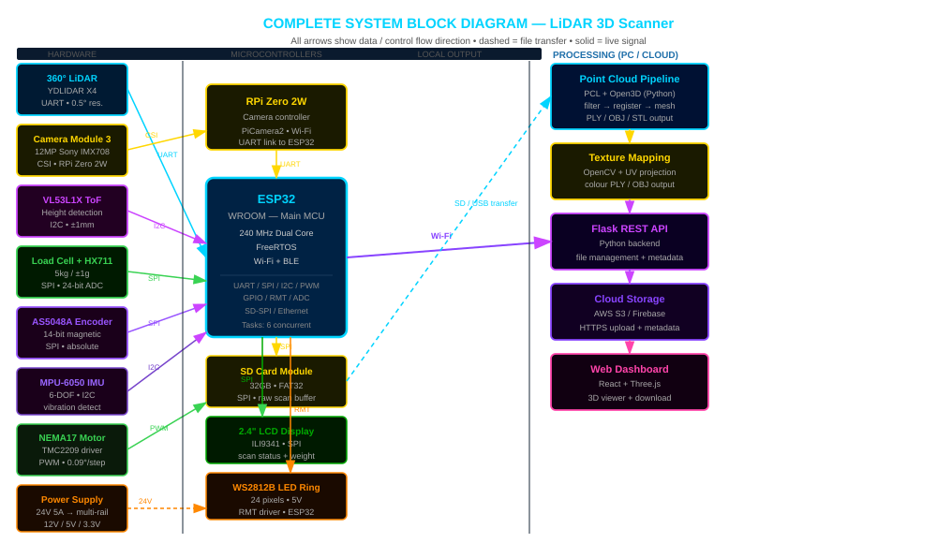
04 — Implementation | Complete System Block Diagram
Slide 5 (Updated)
Solid arrows = live signal / data flow | Dashed arrow = SD card / USB file transfer | Wi-Fi arrow = compressed 3D model upload to cloud

